Slide 1
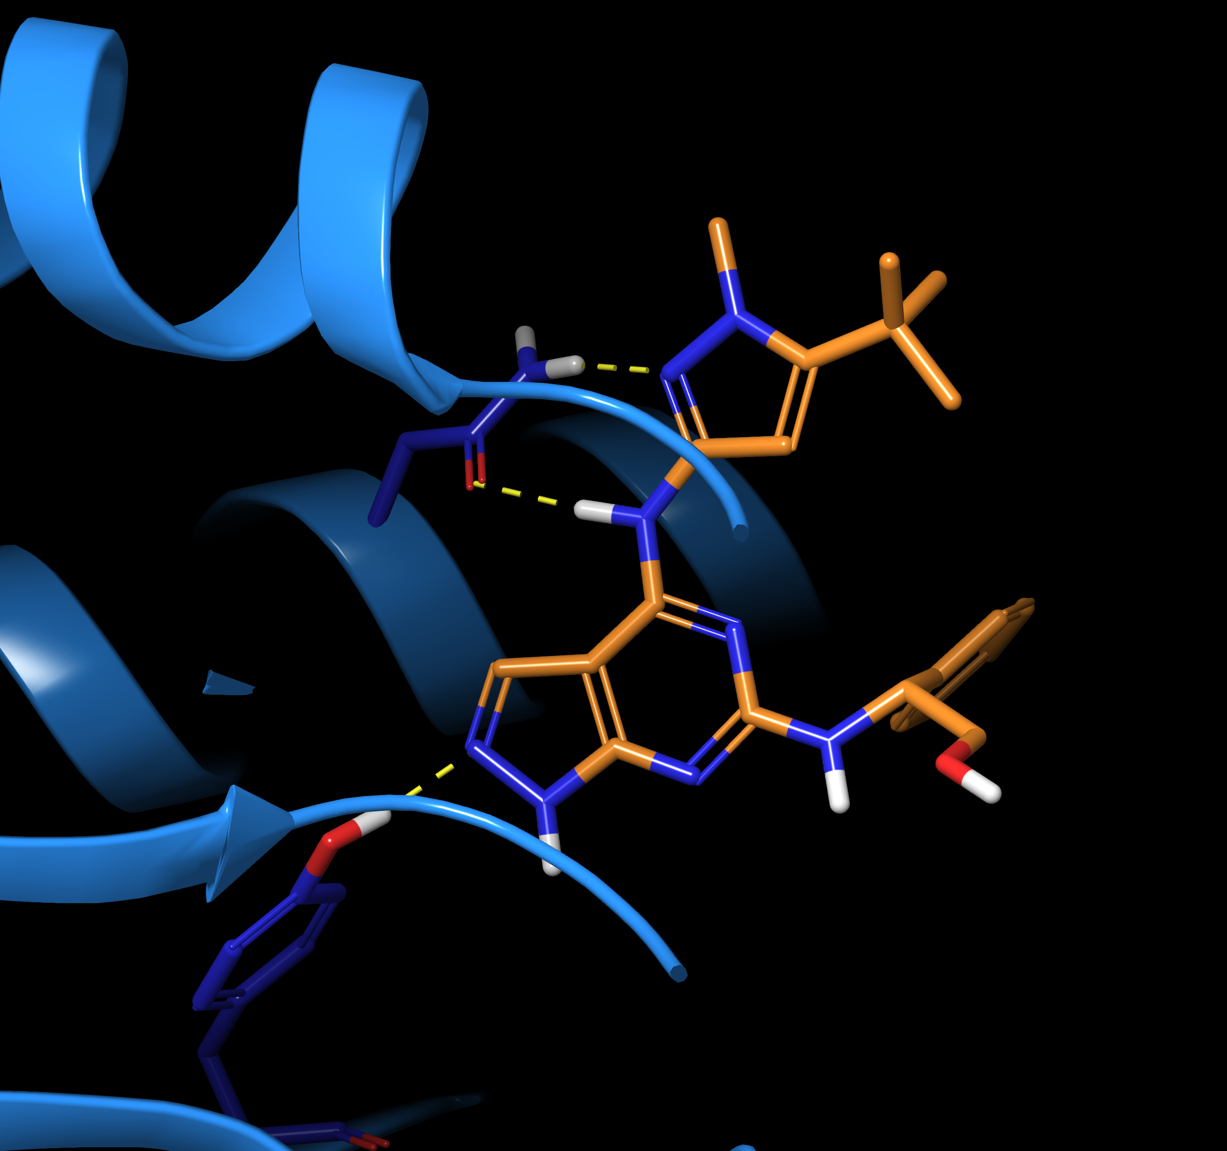










Open Source Antibiotics Series 1 – Mur Ligases
CORE
PRO BONO
SYNTHESIS
SAMPLES/EXPERTISE
CRYSTAL TRIALS
EXPERTISE
MurC – AZ inhibitor, Sept 2020
ENZYMOLOGY
FRAGMENTS
AI/ML
92 NEW SAMPLES
INFORMATICS
New small molecules identified that inhibit more than one mur ligase.
This ”multi-targeting” means emergence of resistance is less likely.

